Slide 1
Securing the skill of using a pair of compasses
Constructions

Slide 2
how to use Oak lessons

Slide 3
I can use a pair of compasses to draw different circles.

Slide 4
The radius is any line segment that joins the centre of a circle to its edge.
A pair of compasses is a tool which can be used to draw circles and arcs. A pair of compasses is sometimes referred to just as a compass.

Slide 5

Securing the skill of using a pair of compasses
Drawing diagrams containing multiple circles
Drawing circles that intersect exactly once

Slide 6
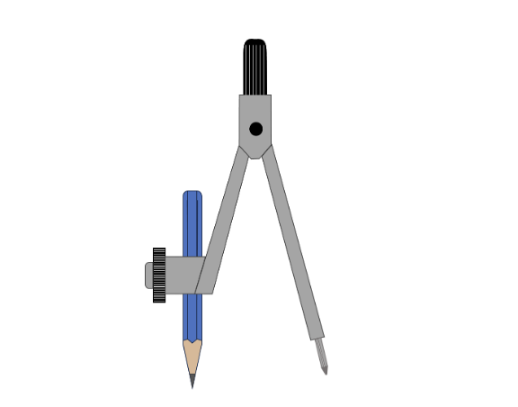
Drawing diagrams containing multiple circles
A pair of compasses and a ruler can be used to draw a circle with a specific radius.
The needle of the compass goes in the centre of the circle.
The distance between the needle and the pencil tip is equal to the radius of the circle.
The pencil is rotated around the needle to inscribe the circle.
radius

Slide 7
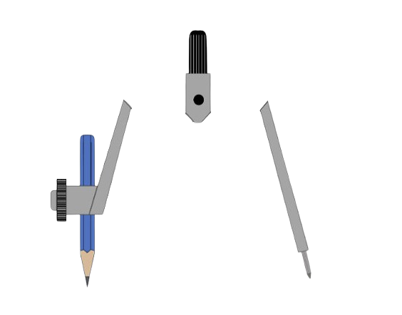
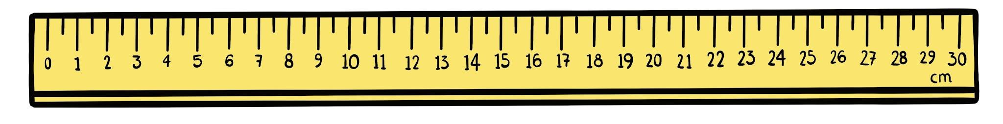
Drawing diagrams containing multiple circles
Take a plain piece of paper and draw a circle with a radius of 5 cm.
Open up the pair of compasses so that the distance between the needle and pencil tip is 5 cm.
You may find it easier to draw a 5 cm line segment first and use that to open your pair of compasses up to the correct distance.
Place the needle at the centre point and draw a circle.

Slide 8


Drawing diagrams containing multiple circles
Sofia has got her pair of compasses ready to draw a circle. Which statement will be true?
The radius will be 9 cm.
The diameter will be 9 cm.
The radius will be 8 cm.
The diameter will be 8 cm.

Slide 9
Drawing diagrams containing multiple circles
Take a plain piece of paper and mark a cross somewhere near the middle of the page.
Using a pair of compasses, draw a circle with radius of 8 cm and the cross at the centre.
Draw two radii in your circle.
Use a ruler to accurately measure the length of each radius.
Are both of the radii in your circle 8 cm?

Slide 10
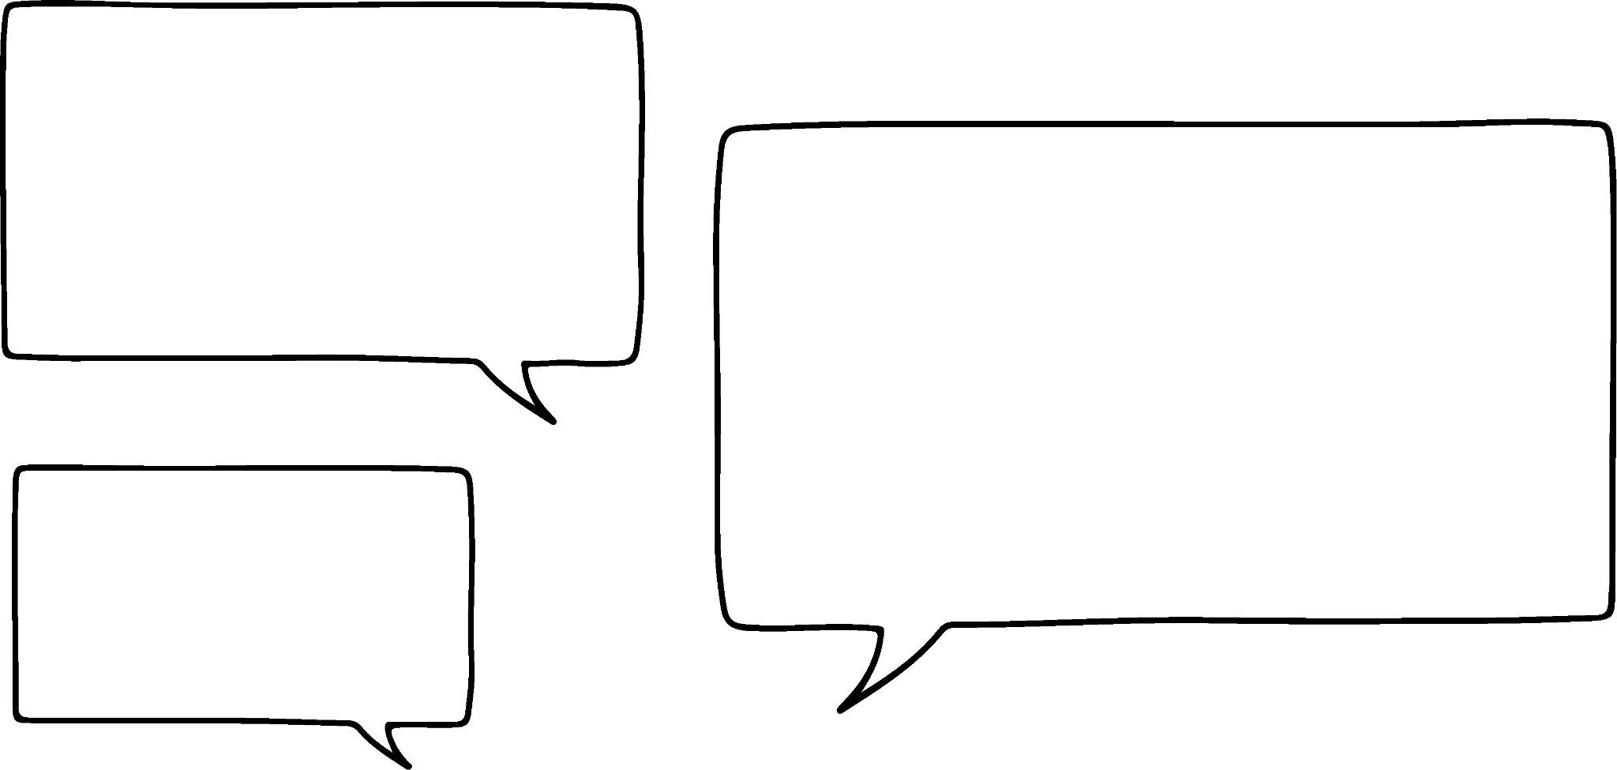
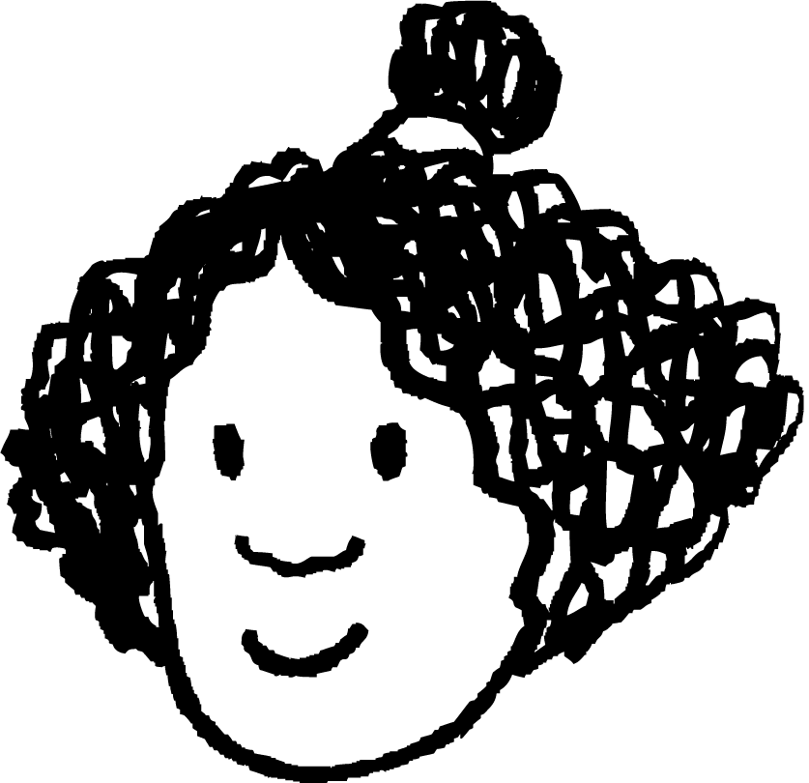
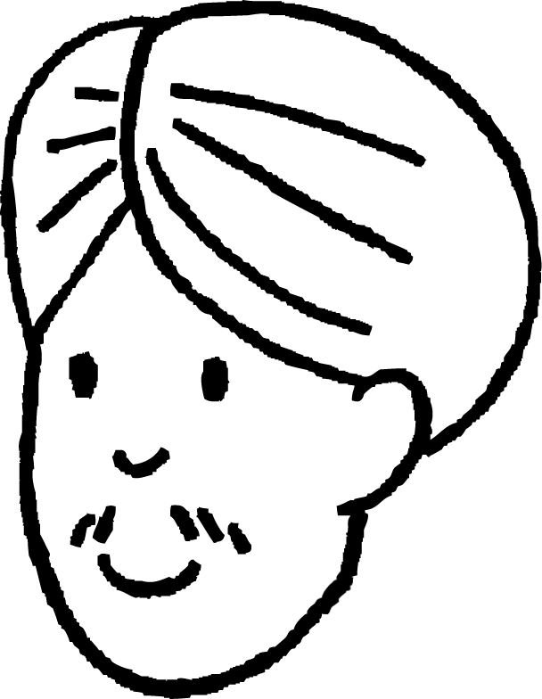


Drawing diagrams containing multiple circles
Andeep, Izzy, Jun and Sam each draw two circles. One circle has a radius of 5 cm and the other has a radius of 8 cm.
Recreate the drawings for each pupil.
My circles do not touch anywhere on the page.
My circles intersect at two points.
My circles intersect at two points.
My circles do not touch anywhere on the page.
The centre of one circle can be found somewhere inside the other circle.
The centre of each circle can be found somewhere inside the other circle.

Slide 11
Drawing diagrams containing multiple circles
Andeep, Izzy, Jun and Sam each draw two circles. One circle has a radius of 5 cm and the other has a radius of 8 cm.
Here are Andeep’s drawings:
My circles do not touch anywhere on the page.

Slide 12
Drawing diagrams containing multiple circles
Andeep, Izzy, Jun and Sam each draw two circles. One circle has a radius of 5 cm and the other has a radius of 8 cm.
Here are Izzy’s drawings:
My circles intersect at two points.

Slide 13
Drawing diagrams containing multiple circles
Andeep, Izzy, Jun and Sam each draw two circles. One circle has a radius of 5 cm and the other has a radius of 8 cm.
Here are Jun’s drawings:
My circles intersect at two points.
The centre of one circle can be found somewhere inside the other circle.

Slide 14
Drawing diagrams containing multiple circles
Andeep, Izzy, Jun and Sam each draw two circles. One circle has a radius of 5 cm and the other has a radius of 8 cm.
Here are Sam’s drawings:
My circles do not touch anywhere on the page.
The centre of each circle can be found somewhere inside the other circle.

Slide 15


Drawing diagrams containing multiple circles
Alex has drawn a circle with radius 8 cm.
He prepares to draw a circle with radius of 5 cm by marking a point for its centre.
The distance between the two centre points is 2 cm.
Alex and Lucas are trying to decide whether the circles will touch.
I think they will because the radius will be 5 cm, but the point is only 2 cm from the centre of the first circle.
I think they won’t because the radius will be 5 cm, but the point is 6 cm from the nearest point on the first circle.
2 cm
Alex
Who do you agree with?
Lucas

Slide 16
Drawing diagrams containing multiple circles
The radius of the large circle is 8 cm.
The centre of the small circle is 2 cm along this radius.
8 cm
5 cm
The radius of the small circle is 5 cm.
2 cm
This will not be far enough to meet the large circle.
The circles will not touch.

Slide 17
Drawing diagrams containing multiple circles
Which statement is true about the two circles?
The circles do not touch.
The circles touch once.
The circles intersect at two points.

Slide 18
Drawing diagrams containing multiple circles
Which statement is true about the two circles?
Neither circle has its centre point inside the other circle.
One circle has its centre point inside the other circle.
Both circles have their centre point inside the other circle.

Slide 19
Drawing diagrams containing multiple circles
1) For each question, draw two circles: one with a radius of 5 cm and the other with a radius of 7 cm. Mark the positions of their centre points each time. Draw each pair of circles according to the following conditions:
a) The circles do not touch. Neither circle has its centre point inside the other circle.
b) The circles intersect at two points. Neither circle has its centre point inside the other circle.
c) The circles intersect at two points. One circle has its centre point inside the other circle.
d) The circles intersect at two points. Both circles have their centre point inside the other circle.
e) The circles do not touch. Both circles have their centre point inside the other circle.

Slide 20
Drawing diagrams containing multiple circles
1) For each question, draw two circles: one with a radius of 5 cm and the other with a radius of 7 cm. Mark the positions of their centre points each time. Draw each pair of circles according to the following conditions:
To check, measure the distance between the two centre points in each question.
a) The circles do not touch. Neither circle has its centre point inside the other circle.
b) The circles intersect at two points. Neither circle has its centre point inside the other circle.
12 cm < distance
7 cm < distance < 12 cm

Slide 21
Drawing diagrams containing multiple circles
c) The circles intersect at two points. One circle has its centre point inside the other circle.
d) The circles intersect at two points. Both circles have their centre point inside the other circle.
e) The circles do not touch. Both circles have their centre point inside the other circle.
5 cm < distance < 7 cm
2 cm < distance < 5 cm
distance < 2 cm

Slide 22
Securing the skill of using a pair of compasses
Drawing diagrams containing multiple circles
Drawing circles that intersect exactly once

Slide 23

Drawing circles that intersect exactly once
Laura draws two circles. One circle has a radius of 4 cm and the other has a radius of 8 cm.
Here are Laura’s drawings:
12 cm
4 cm
My circles touch each other exactly once.
8 cm
How far apart are the two centre points?

Slide 24
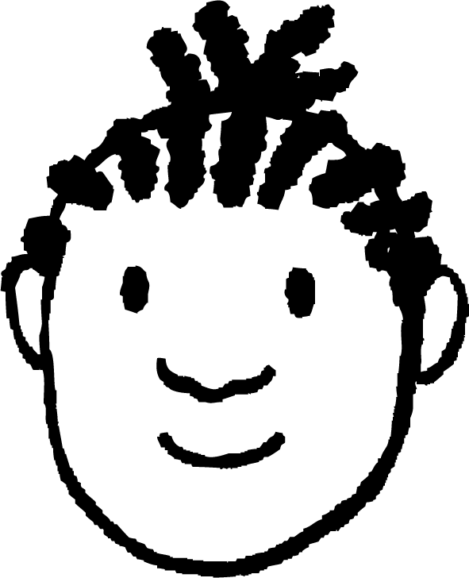
Drawing circles that intersect exactly once
Jacob wants to redraw the circles below so that they touch exactly once. How far apart should he draw the two centre points?
6 cm
4 cm
6 cm
4 cm

Slide 25
Drawing circles that intersect exactly once
Jacob wants to redraw the circles below so that they touch exactly once. How far apart should he draw the two centre points?
4 + 6 = 10
6 cm
4 cm
10 cm
or

Slide 26
Drawing circles that intersect exactly once
Jacob wants to redraw the circles below so that they touch exactly once. How far apart should he draw the two centre points?
4 + 6 = 10
4 cm
6 cm
or
2 cm
6 − 4 = 2

Slide 27

Drawing circles that intersect exactly once
Aisha draws two points 9 cm apart. She wants to draw a circle around each point, with them touching each other exactly once.
What radius could she use for each circle?
9 cm
Any pair of positive numbers that sum to 9 (e.g. 6 and 3).
Any pair of positive numbers with a difference of 9 (e.g. 12 and 3).

Slide 28
Drawing circles that intersect exactly once
The two centre points in each diagram are 10 cm apart. All lengths are given in cm. In which diagram could the measurements be correct?
4
4
4
5
6
7

Slide 29
Drawing circles that intersect exactly once
The two centre points in each diagram are 10 cm apart. All lengths are given in cm. In which diagram could the measurements be correct?
4
4
4
6
10
14

Slide 30
Drawing circles that intersect exactly once
How far apart would the centre points of these two circles need to be for the circles to touch exactly once?
8 cm
5 cm

Slide 31
Drawing circles that intersect exactly once
How far apart would the centre points of these two circles need to be for the circles to touch exactly once?
8 cm + 5 cm = 13 cm
or
8 cm − 5 cm = 3 cm

Slide 32
Drawing circles that intersect exactly once
1) For each question, draw two circles: one with a radius of 5 cm and the other with a radius of 7 cm. Mark the positions of their centre points each time. Draw each pair of circles according to the following conditions:
a) The circles touch exactly once. Neither circle has its centre point inside the other. b) The circles touch exactly once. One circle has its centre point inside the other.
2) Draw two points 12 cm apart. Draw a circle around each point so that they touch each other exactly once. What is the radius of each circle?

Slide 33
Drawing circles that intersect exactly once
3) Points A, B, C and D are on the same line. Draw an accurate version of the diagram.
A
B
C
D
3.5 cm
3 cm
4 cm
6 cm

Slide 34
Drawing circles that intersect exactly once
1) For each question, draw two circles: one with a radius of 5 cm and the other with a radius of 7 cm. Mark the positions of their centre points each time. Draw each pair of circles according to the following conditions:
To check, measure the distance between the two centre points in each question.
a) The circles touch exactly once. Neither circle has its centre point inside the other.
b) The circles touch exactly once. One circle has its centre point inside the other.
distance = 12 cm
distance = 2 cm

Slide 35
Drawing circles that intersect exactly once
2) Draw two points 12 cm apart. Draw a circle around each point so that they touch each other exactly once. What is the radius of each circle?
Any pair of positive numbers that sum to 12 (e.g. 6 and 6).
or
Any pair of positive numbers with a difference of 12 (e.g. 14 and 2).

Slide 36
Drawing circles that intersect exactly once
3) Points A, B, C and D are on the same line. Draw an accurate version of the diagram.
A
B
C
D
3.5 cm
3 cm
4 cm
6 cm
To check, measure the distance between points A and D. It should be 17.5 cm.

Slide 37
Securing the skill of using a pair of compasses
A pair of compasses can be used to draw a circle with a specific radius.
A pair of compasses can be used to draw two circles that intersect.
A pair of compasses can be used to draw two circles that intersect exactly once.
Drawing with a pair of compasses becomes easier over time with practice.

Slide 38

© Oak National Academy 2023.
Produced in partnership with Mathematics in Education and Industry.
Licensed on the Open Government Licence v3.0, except where otherwise stated. See Oak terms and conditions.

